Slide 1
EU Ports Strategy
Joke Bamps, Unit Ports, Security and Inland Navigation (MOVE.D.3), European Commission

Slide 2
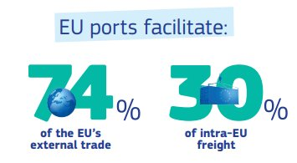
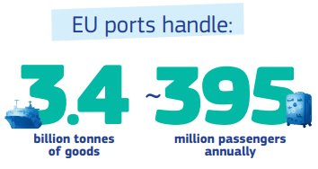
The strategic role of EU ports
Ports are critical infrastructure at the heart of Europe’s economy, security and sustainability.
Gateways to global trade: EU ports handle over 3.4 billion tonnes of goods (74% of EU external trade) and nearly 400m passengers annually.
Drivers of competitiveness and industrial strength: Ports underpin the EU’s export capacity, supply chains and logistics networks, supporting around 423.000 direct jobs and generating approximately €90 billion turnover.
Energy and climate transition hubs: Around 40% of cargo handled is energy-related, positioning ports as key platforms for electrification, offshore wind deployment, hydrogen imports and alternative fuels infrastructure.
Anchors of the blue economy and coastal cohesion: Ports sustain coastal, island & OR communities, fisheries, maritime clusters and regional economies, contributing to territorial cohesion and sustainable blue growth.
Pillars of resilience, economic security and defence: Ports are strategic dual-use infrastructure, critical for supply chain resilience, military mobility and protection against cyber, hybrid and organised crime threats.

Slide 3
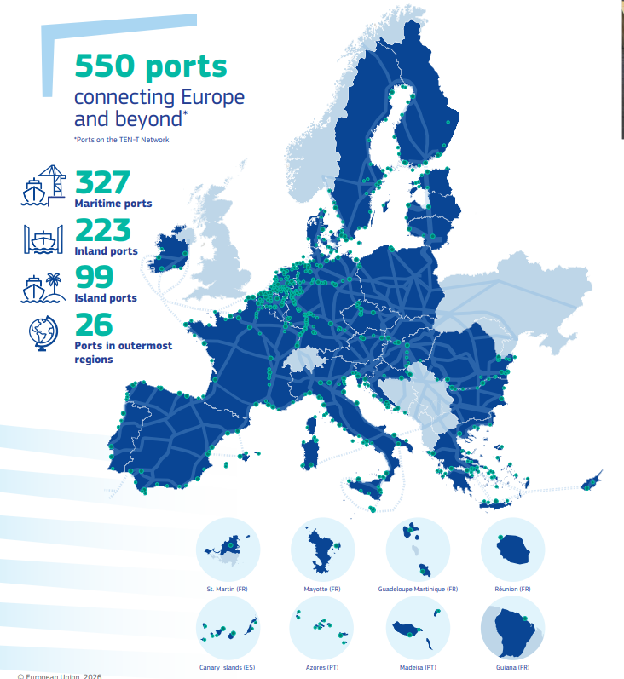
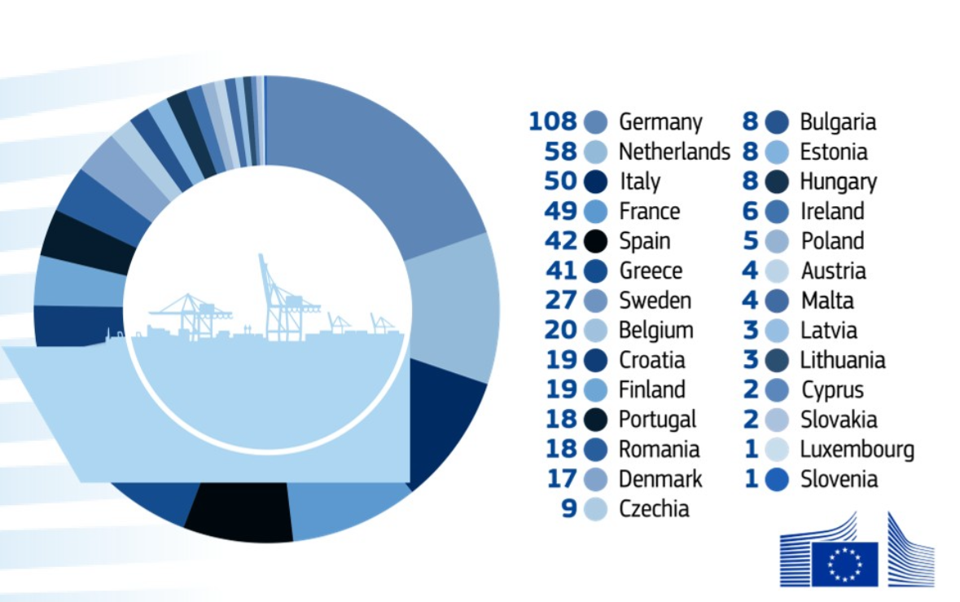
EU ports in numbers
Europe’s economic security, clean industrial transition and global connectivity depend on strong, competitive, sustainable and secure ports.

Slide 4
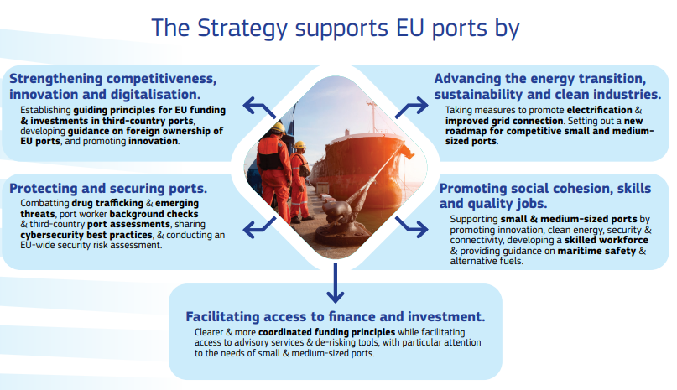
EU Ports Strategy: 5 pillars
Boosting the competitiveness, security and sustainability of EU ports

Slide 5
Pillar I – Competitiveness, Innovation & Digitalisation
Flagship Actions
Support the digital and green transformation of European ports through innovation, promoting scale-up, replication and uptake of innovative port equipment and technologies.
Develop guidance to Member States with criteria for assessing foreign investments in ports & a framework for mapping and monitoring foreign investments in ports.
Use guiding principles for EU funding and investments in third country ports (Annex 1).
Key elements
Competitiveness:
EU ports compete for global trade, investment and logistics flows.
Level-playing field with 3rd country ports.
Efficient hinterland connections and logistics chains are essential advantages.
Economic security
Risks and opportunities of foreign ownership and influence in strategic port infrastructure.
Digital systems and logistics platforms are part of strategic infrastructure.
Innovation & digitalisation
New technologies (AI, automation, clean technologies) boost efficiency and sustainability.
Digital solutions optimise port calls, logistics chains and data sharing.
Recommendations to Member States
Play a leading role in setting global technical standards.
Prevent, mitigate and tackle the risks associated with foreign ownership and control of strategic dual-use port infrastructures.
Streamline land use planning and permitting procedures for additional areas for port use and take-up of innovation in ports.
Aim for a balance between return on investments for private operators and suitable contractual obligations.

Slide 6
Pillar II – Energy Transition, Sustainability & Clean Industries
EU ports are central to the decarbonisation of maritime transport and industry. They are key gateways for renewable energy, hydrogen imports and clean fuels, and essential to achieving EU climate and energy objectives.
Flagship Actions
Accelerate permit-granting and provide faster assessment procedures for strategic energy, recycling and decarbonisation port-related projects, through the Grids Package and the Environmental Omnibus.
Accelerate port electrification, provide timely and non-discriminatory access to the grids.
Promote partnerships for energy cooperation in and around port areas for sustainable use of energy, including hydrogen.
Key challenges
Investment needs for OPS and alternative fuels infrastructure
Grid capacity constraints in major port areas
Slow and complex permitting procedures
Risk of fragmentation and uneven deployment across Member States
Recommendations to Member States
Prioritise port electrification and grid reinforcement in national energy plans.
Allocate a part of ETS revenues to maritime decarbonisation investments across the maritime cluster, incl. sustainable infrastructure and OPS.
Streamline permitting procedures for strategic port energy projects.
Facilitate coordination between transport, energy and industry authorities.

Slide 7
Pillar III – Protect & Secure Ports
EU ports are critical infrastructures for trade, energy supply and military mobility. Growing threats from organised crime, cyberattacks and hybrid risks require stronger protection of port operations and logistics chains.
Flagship Actions
Update and revise existing guidance, including on emerging threats, and promote a global level playing field for EU ports security.
Building on the work of the European Ports Alliance, establish frameworks for third-country port assessments & improve alignment of customs controls across EU ports together
Establish framework for background checks for port workers.
Establish a forum for Member States’ cybersecurity and port authorities to exchange best practices & carry out an EU-wide security risk assessment to identify the most pressing cybersecurity risks and appropriate measures to mitigate them.
Key challenges
Organised crime infiltration in container logistics and port operations.
Increasing cybersecurity vulnerabilities in digital port systems.
Emerging hybrid threats (GNSS interference, drones, sabotage).
Risks linked to foreign control of strategic port infrastructure.
Recommendations to Member States
Strengthen port security controls and inspections
Improve cooperation between ports, customs and law enforcement
Ensure full implementation of cybersecurity requirements
Assess security risks related to foreign investments in ports

Slide 8
Pillar IV – Access to Finance & Investment
EU ports face significant investment needs driven by:
Decarbonisation and energy infrastructure (OPS, clean fuels).
Growing trade flows and larger vessels.
Security, resilience & digitalisation
Climate adaptation & sustainability
A mix of EU, national and private funding, supported by predictable regulatory frameworks and de-risking tools, will be essential.
EU support for port investments
Since 2014, the EU has supported port projects with ~€10 billion in deployment funding and €200+ million in R&I.
EIB Group has supported port projects with €2.8bn (2014–2025)
Next step: CEF will prioritise Onshore Power Supply (OPS) in a 2026 call.
Flagship Actions:
Set overall priorities and conditions for all funding instruments (Annex 1).
Engagement with national promotional banks and private investors.
Improving access to financing and project preparation via EIB.
Encourage the sector to “think out of the box” (by supporting ports to diversify into clean energy, digital and blue tech services – using targeted EU funding, advisory support and PPPs to de-risk innovative projects).

Slide 9
Pillar V – Social cohesion, Skills & Jobs
The green and digital transition will transform port operations. Ensuring skilled workers, quality jobs and safe working conditions is essential for the long-term competitiveness and social sustainability of EU ports.
Flagship Actions
A new roadmap for competitive small and medium ports (Annex 2).
Strengthen dialogues and support the development of best practices and guidance on enhancing port-city relations.
Support upskilling and reskilling initiatives, incl. the development of a skilled next-generation workforce across all blue economy sectors, including ports, through actions under the Blue Generational Renewal Strategy.
Support social partners and relevant stakeholders to establish a Pact for Skills for the ports sector on upskilling, reskilling and inclusion of workers.
Prepare guidance on (i) onboard safety for workers and (ii) safe handling of new fuels.
Key challenges
Ports vital for connectivity (arctic, coastal, islands, outermost regions).
Workforce up-/reskilling for digitalisation, clean energy and alternative fuels.
Ensuring safe working conditions and quality jobs in port operations.
Recommendations to Member States
support infrastructure, clean energy and fuel, safety, and sustainability improvements for small and medium sized-ports.
Ensure implementation and respect of Union and national labour legislation and collective bargaining agreements.

Slide 10
Process & Next Steps
Extensive consultation carried out with all stakeholders, including Member States:
Call for Evidence;
European Ports Forum meetings;
Strategic dialogues hosted by Commissioner Tzitzikostas.
See Staff Working Document (Stakeholder Consultation - Synopsis Report).
Cooperation with Member States
Successful implementation will be based on cooperation with:
Member States and port authorities
Industry and social partners
Port and all relevant stakeholders.
Delivering the Strategy together
Establish a high-level Maritime Industries and Ports Board chaired by the responsible Commissioner and EVPs to have a continued exchange on the implementation of the actions outlined in the Ports strategy.

